Slide 1
The populist threat to liberal democracy
Pippa Norris
Harvard and Sydney Universities
www.pippanorris.com
CES Summit on the Future of Europe: The Forces of Disunion,

Slide 2
Structure
Explaining rising support for populism
Generational cultural backlash &/or economic inequality
Evidence from Europe: ESS 2002-2014
Evidence from the US: 2016 Exit polls
Conclusions

Slide 3
I: Theories of populism

Slide 4
What is populism?
Anti-establishment
Faith in the wisdom and virtue of ordinary people over corrupt establishment
Anti big banks, multinationals, media, elected politicians, government officials, intellectuals and experts, privileged rich
Authoritarian
Favors strongman outsiders, charismatic leaders, and a direct voice for the people
Mistrusts liberal democracy’s checks and balances and minority rights
Nativism
Nationalism, unilateralism, Us v Them, monoculturalism, isolationism, national self-interest, closed borders, intolerance of ‘outsiders’, traditional values

Slide 5
Contemporary model of party competition
POPULISM
Anti-establishment
Strong leader/popular will
Nationalism
Traditional values
ECONOMIC RIGHT
Free Market/Small state
Deregulation
Low taxation
Individualism
ECONOMIC LEFT
State management
Economic redistribution
Welfare state
Collectivism
COSMOPOLITAN LIBERALISM
Pluralistic democracy
Tolerant multiculturalism
Multilateralism
Progressive values

Slide 6
Rising support for populist parties in Europe
Source: Calculated from ParlGov1

Slide 7
Varied populist fortunes by country
Source: Calculated from ParlGov1

Slide 8
Accelerate populism in European elections?
Austrian presidential elections: 4 Dec 2016: Norbert Hofer FPO
Italian referendum constitutional reform, 4 Dec 2016
The Netherlands, lower house, March 2017: Geert Wilders
France presidential elections 23 April and 7 May 2017: Marine Le Pen, Front National
France Chamber of Deputies July 2017: Front National
Germany: Bundestag, 22 Oct 2017: AfD

Slide 9
Comprehensive explanations
Institutional contexts
e.g. electoral systems and thresholds, referenda and plebiscites, party finance rules, ballot access laws
Demand side
Values and attitudes in the mass electorate
Supply side
Incentives for elite competition and cooperation

Slide 10
Explaining populism: Economic insecurity
1950s and 1960s Seymour Martin Lipset and Daniel Bell Fascism in Weimar Germany, Poujadism in France, McCarthyism in the US
Authoritarian reaction against modernity by petite bourgeoisie fearing downward mobility squeezed between big business and organized labor
Today emergence of new under-class in global markets, low-skilled, low-wages, benefit-dependent, poor job security, vulnerable to social risks
Evidence: (i) absolute inequality (ii) relative inequality (iii) socio-tropic conditions
If absolute inequality, at micro-level populist support should be concentrated among economically marginalized - unskilled workers, those lacking college degrees, unemployed, welfare dependent, and with subjective feelings of economic insecurity
Period effects should be observed around 2008 recession

Slide 11
Explaining populism: Cultural backlash
Rise of progressive values during the 1970s, especially among younger cohorts and college educated in Western societies
Value secular, cosmopolitan, open-mindedness towards diversity of lifestyles, support for international cooperation and global governance, diverse forms of sexuality and gender identities, LGBT rights, same sex marriage
Catalyzed a cultural backlash among traditionalists – a tipping point threatens the once predominant values and status of several sectors – older generations, men, white population - on issues such as faith, family, patriotism, and nationalism.
If so, at micro-level, populism should be predicted by generation/birth cohort, plus religiosity, education and sex – as well as by traditional attitudes and authoritarian values
Cohort effects should be observed in trends over time

Slide 12
II: Evidence in Europe

Slide 13
Generational gaps in voting for populism in Europe

Slide 14
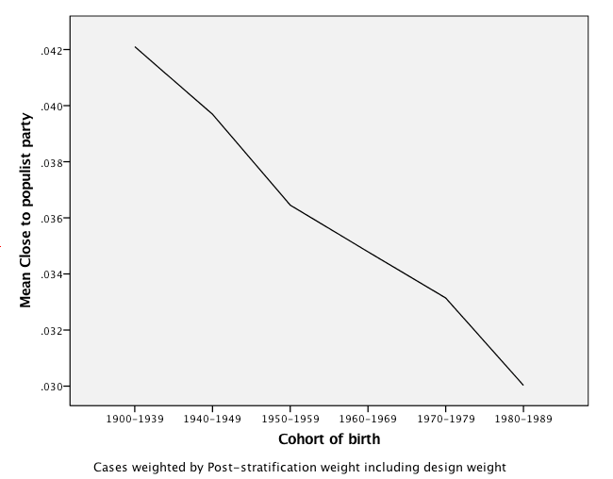
Generational gaps in partisanship in Europe
Source: Pooled European Social Survey 1-6

Slide 15
Generational gaps in anti-immigrant attitudes
Source: Pooled European Social Survey 1-6

Slide 16
Generational gaps in authoritarian values
Note: Importance of obey, safe, rules, strong government, tradition. Source: Pooled European Social Survey 1-6

Slide 17
Generational gaps towards anti-globalization
Source: Pooled European Social Survey 1-6

Slide 18
II: Evidence in US

Slide 19
Most important issues by vote 2016

Slide 20
Generation gap in GOP vote, US elections

Slide 21
% Vote by income, 2016

Slide 22
Education gaps

Slide 23
IV: Conclusions and implications

Slide 24
“There are millions of ordinary Americans who have been let down, who have had a bad time, who feel the political class in Washington is detached from them, who feel so many of their representatives are politically correct parts of that liberal media elite. You can go out, you can beat the pollsters, you can beat the commentators, you can beat Washington.”
Nigel Farage speech at a Trump rally in Jackson, Mississippi, 24 Aug 2016

Slide 25
Populist challenges to liberal democracy
To international stability: threats to the post-war consensus of multilateral cooperation, global governance, and international engagement;
To democracy: 3rd reverse wave? Undermine human rights and democratic values, accelerating erosion abroad, encouragement to strongmen authoritarian regimes worldwide
To elections: eroding support for mainstream parties on center right and center left
To public sector management: Personalities, values, simplistic slogans, and vague platforms undermine evidence-based technocratic policy analysis and weaken programmatic accountability
To representative institutions: Referenda challenge the legitimacy of parliamentary leaders; deepen internal tensions within parties
To social stability: growing tensions and deepening divisions

Slide 27
More details
Pippa Norris and Ronald Inglehart
Trump, Brexit, and the Rise of Populism: Economic Have-Nots and Cultural Backlash
HKS Faculty Working Paper RWP16-026

Slide 28
Growing education gaps, GOP Vote

Slide 29
Income gaps

Slide 30
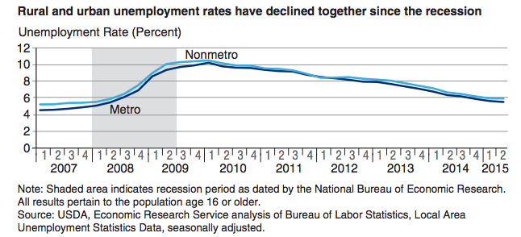
Rural unemployment rate, US 2007-2015

