Slide 1
From Enlargement to Brexit: the Future of the European Union
R. Daniel Kelemen
Professor of Political Science and Law
Jean Monnet Chair in European Union Politics
Rutgers University

Slide 2
Outline
A preface on enlargement and Brexit
Europe’s Polycrisis
Failing Forward and its limits
Quo vadis?

Slide 3
From Enlargement to Brexit
Irony 1: UK championed enlargement & opened labour market before required, then complained about result
Irony 2: UK promoted enlargement in part due to belief that widening would discourage deepening. The opposite was true.

Slide 4
Widening and Deepening
Widening and deepening have gone together
Widening only leads to legislative gridlock in limited circumstances
Widening enhances power of bureaucrats and judges, and encourages institutional reforms that support deepening
Eventually, deepening went too far for the UK

Slide 5
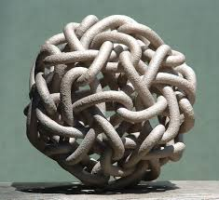
The EU’s Perfect Storm or “Polycrisis”
Unresolved refugee crisis
Festering eurozone crisis
Brexit crisis
Crisis of democratic backsliding by member governments (ie Hungary and Poland)
Crisis of Russian aggression on eastern flank
The Question: Is integration proceeding through crisis? Or is the “polycrisis” unraveling the EU?

Slide 6
Is integration proceeding through crisis?
Europe will be forged in crises, and will be the sum of the solutions adopted for those crises. – Jean Monnet, 1978
I am sure the euro will oblige us to introduce a new set of economic policy instruments. It is politically impossible to propose that now. But some day there will be a crisis and new instruments will be created. - Romano Prodi, 2001
As on other occasions in European history, this crisis offers a chance to progress; we must be ready to act on it. Let us not waste this opportunity to advance European integration. – Peter Praet, Member of ECB Executive Board, 2012
The migration and refugee crisis [is] an existential challenge for the EU. – Donald Tusk, Jan 2016

Slide 7
Integration through Crisis: EU often integrates through “Failing Forward”
Intergovernmental bargains
Incomplete Governance Structures
Functional Spillovers
Crisis

Slide 8
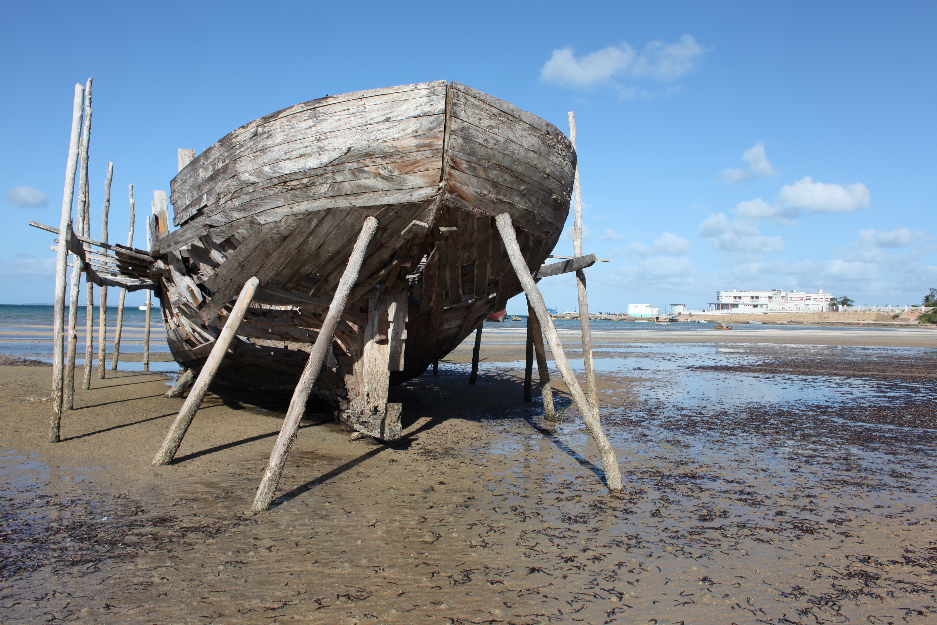
“The incompleteness of the euro design is Europe’s Achille’s Heel.” -Mario Draghi

Slide 9
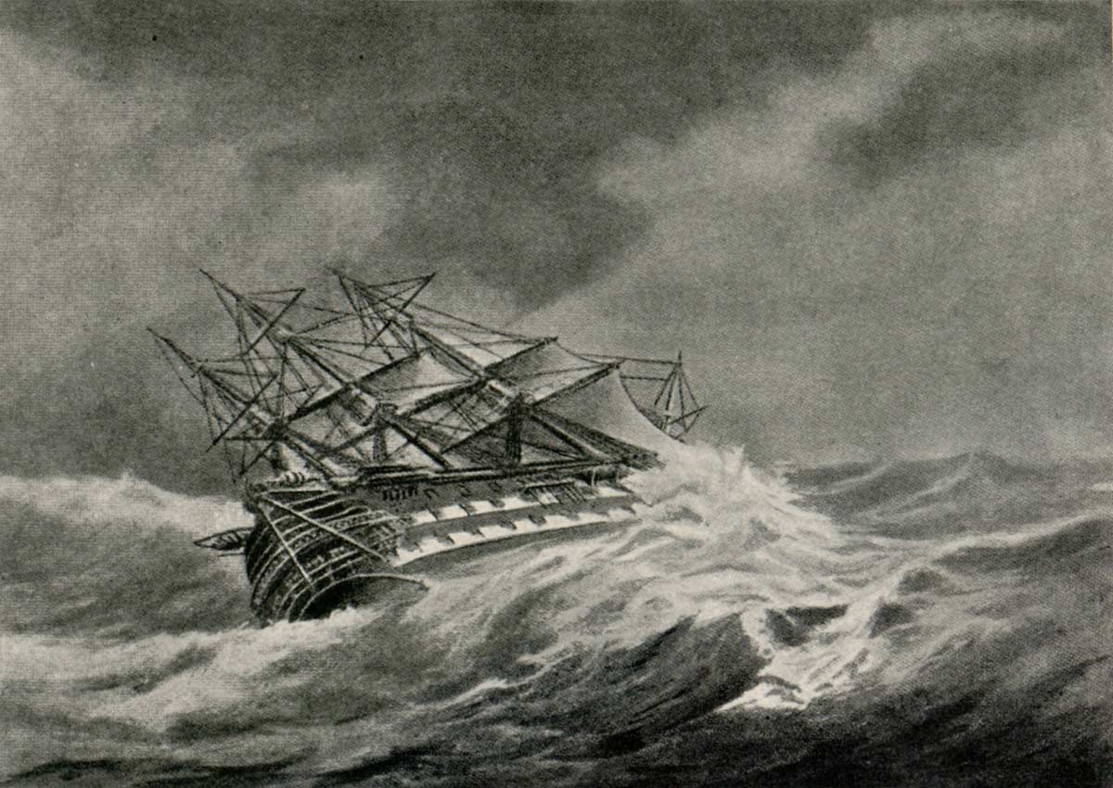
Then comes stormy weather

Slide 10
EMU as an Incomplete Construction
Limited fiscal integration:
Small budget, no countercyclical redistribution
Flawed fiscal rules in Maastricht Treaty
Weak and fragmented banking regulations
Pan-European banking, with national regulation
Inadequate mechanisms to promote macroeconomic adjustment or convergence

Slide 11
Response to eurozone crisis: Deepening through failing forward
Incremental, but cumulatively substantial, steps toward:
Fiscal Union
Banking Union
Debt Union
Political Union

Slide 12
EU migration policy as incomplete construct
Borderless internal movement incompatible with nat’l control over external borders & asylum
Either EU will increase control over borders & asylum
Or, Schengen area will collapse
Current system encourages race-to-the-bottom and asylum-shopping
Response thus far:
Temporary suspensions of Schengen, Dublin
Strengthening of EU asylum policy and replacing weak Frontex w/ European Border and Coast Guard

Slide 13
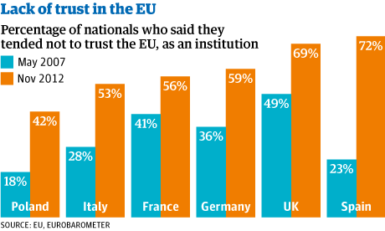
But failing forward is self-undermining
Integration via “failing forward” erodes public support for EU, so it is unsustainable

Slide 14
& Failing forward may be disrupted when crises intersect
Half-baked responses to one crisis may generate problems that help spark new crises in different fields
Failure to confront eurozone crisis and refugee crisis more effectively feeds negative perceptions that help lead to Brexit (a new crisis)
Failure to confront rise of autocracy in Hungary:
makes it harder to confront rise of similar regime in Poland
makes it harder to confront migration crisis effectively
allows Hungary to act as Trojan horse for Putin

Slide 15
Quo vadis?
Further fragmentation?
Rush to deepening or more failing forward?
Towards a (more) Political Union?

Slide 16
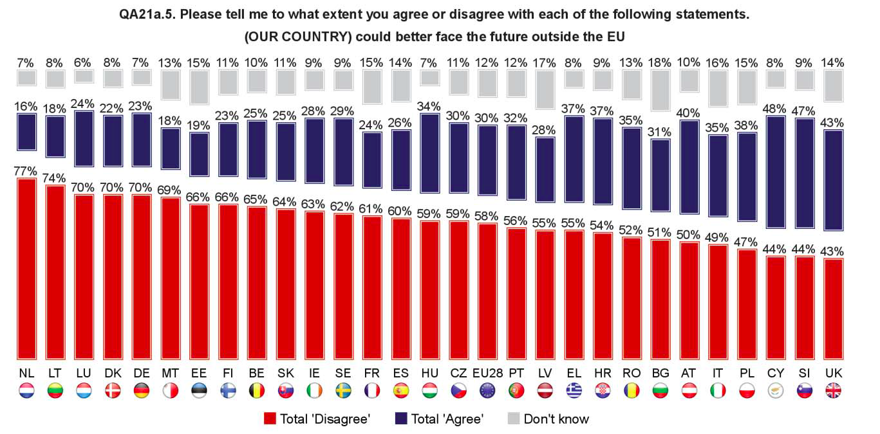
No other population has appetite for Leaving EU

Slide 17
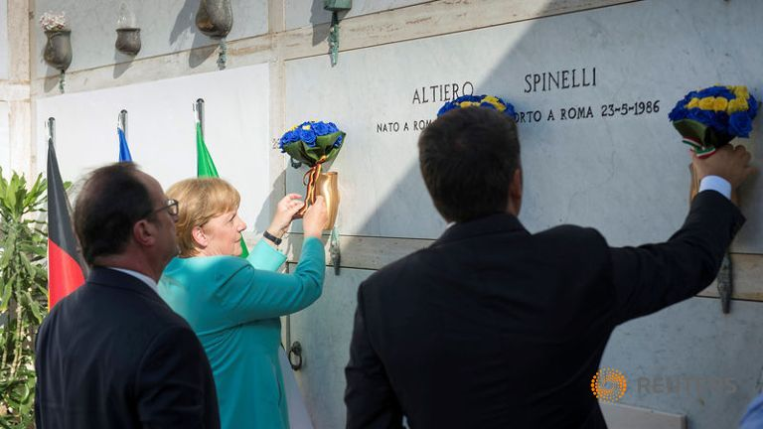
Post-Brexit Deepening? Ventotene island Summit

Slide 18
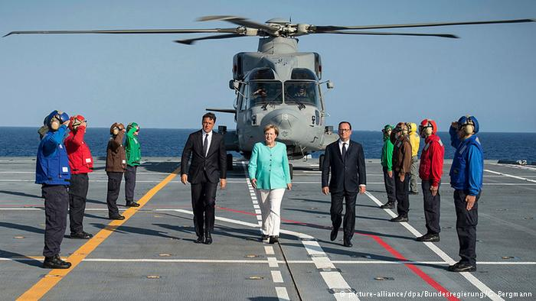
Deeper integration?

Slide 19
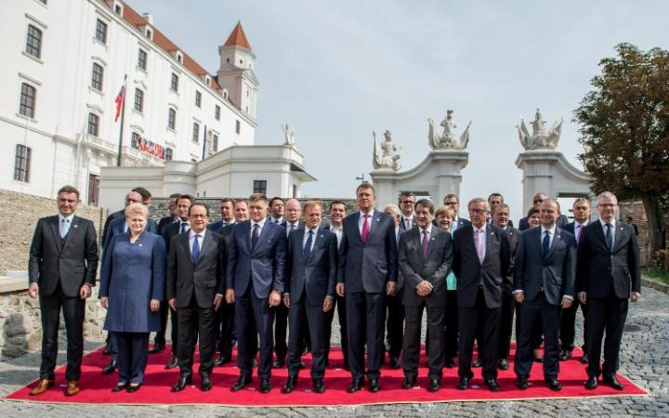
Bratislava summit of the EU27

Slide 20
Bratislava Declaration and Roadmap
PR exercise – and a failed one
Focus on Migration & Border Security, Internal Security and Defense, Economic Development
Little of substance agreed, beyond agreement to continue talking at upcoming summits
Trump election makes progress on defense cooperation more likely

Slide 21
Political Union?
Critics say ultimately EMU is only sustainable if embedded in “political union”
Recent proposals rom Barroso, Van Rompuy, Future of Europe Group, Piketty & friends, etc
EU has always been a political union, albeit limited one
Lisbon Treaty deepened political union:
More traditional “core state powers”: foreign affairs, immigration, police & judicial
More democracy: Lisbon empowered EP and 2014 “Spitzenkandidat” process extended this
But EU may not become the political union we want: Democratizing EU enhances incentives for EU parties to protect national autocrats (Orbán, Kaczyński)

