Slide 1
President Trump and the Future of European Security
Graham Allison
November 14, 2016

Slide 2
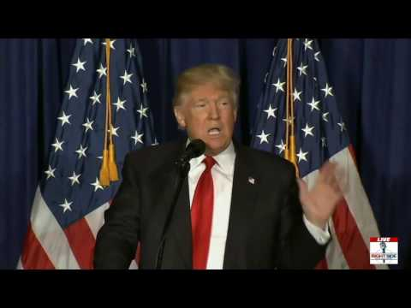
Wake Up to Trump

Slide 3
Trump’s Coordinates on NATO and Europe
NATO is “obsolete”
European members are “freeloaders”
NATO committed to defending countries his supporters “never even heard of”

Slide 4
Anomaly of European Security?

Slide 5
Europe at War?
Conflict | Troop Contributions | European Fatalities
Afghanistan (2001-present) | 39,500 (peak) | 923
Iraq (2003-2011) | 53,300 (peak) | 306
Conflict | Aircraft Contributions | Sorties
Kosovo (1999) | 300 | 15,000
Libya (2011) | 3,800 | 18,000

Slide 6
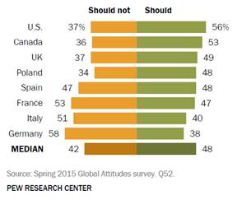
Who Would Fight For Estonia?
Should our country use military force to defend another NATO ally in a serious military conflict with Russia?

Slide 7
Thucydides 21st Century German Question
Is a war between a rising Germany and its European neighbors unthinkable?
If in the next decade, Brexit leads to further unraveling of the EU, and the U.S. withdraws its security guarantee and renegotiates its relationship with NATO, could we see a renationalization of defense in Europe? Could we see a reemergence of Thucydidean dynamics?

